Slide 1

MIS 547
Cloud Computing

Slide 2

Admin
Reminders
01
Assignment 4 Due Sunday @ midnight
02
Office hours
04
By appointment, please schedule in advance!
Lectures 7 & 8 are online only
Quiz 4 Due Sunday @ midnight
03

Slide 3
AGENDA
Agenda:
Routing
DNS
Cloud Networking
NAT
VPCs

Slide 4
Lecture 7: Cloud Networking Day 1

Slide 5
The OSI Model- Intro Video Available

Slide 6
Inter-Network Operations
Sending data from one network to another

Slide 7
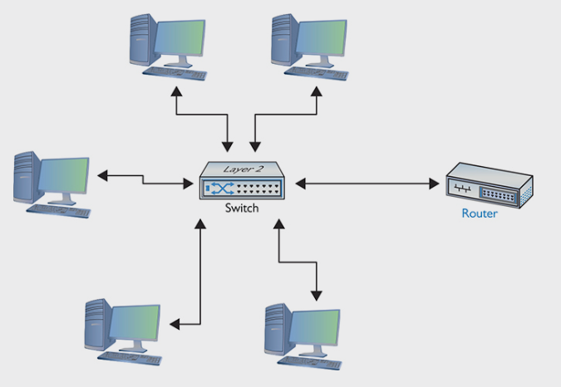
Routers
LAN: Local Area Network
WAN: Wide Area Network
Default Gateway: when you have a router that routes traffic out to other networks, both the router’s interface on a LAN and the router itself are called the default gateway

Slide 8
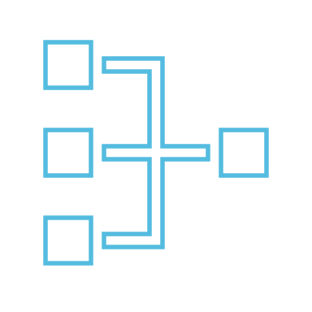
Routers
Routers have multiple network interfaces:
Interface on the LAN (internal network) side, and an interface on the ISP (external) side.
The external interface (facing the ISP) will have a public IP address, and the internal interface will have a private IP address
Default gateway is how we talk to the world outside our LAN
Internal network interface
External network interface
VM
DEFAULT GATEWAY
VM
Router
The Internet
VM
Private IP address
Public IP address

Slide 9
Routers
Router’s LAN interface must have an address in the LAN’s network ID
LAN-side NIC on the default gateway will have the lowest or highest host address
(e.g., 10.0.0.1 or 10.0.0.254)
.255 is reserved as a broadcast address used to talk to every machine on the LAN
Internal network interface
External network interface
10.0.0.2
VM
DEFAULT GATEWAY
10.0.0.3
VM
Router
The Internet
10.0.0.4
VM
10.0.0.1
<Public IP>

Slide 10
Public and Private IP Addresses
On the LAN side of the router are private IP addresses
10.0.0.0 through 10.255.255.255
172.16.0.0 through 172.31.255.255
192.168.0.0 through 192.168.255.255
On the ISP side of the router are public IP addresses
All other IP addresses, except
127.0.0.1: loopback IP
Private IP address ranges:
All 10.x.x.x
172.16.x.x → 172.31.x.x
All 192.168.x.x
Internal network interface
External network interface
10.0.0.2
VM
DEFAULT GATEWAY
10.0.0.3
VM
Router
The Internet
10.0.0.4
VM
10.0.0.1
<Public IP>

Slide 11
Routing
Routing lets us connect LANs to WANs
Inspects the packet’s destination IP address and sends the IP packet out the correct port. To do this, it needs a routing table:
Internal network interface
External network interface
LAN
WAN
10.0.0.2
VM
DEFAULT GATEWAY
10.0.0.3
VM
Router
0.0.0.0
10.0.0.4
VM
10.0.0.1
<Public IP>

Slide 12
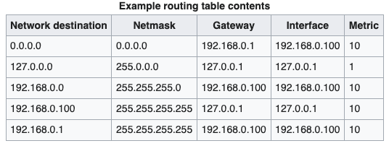
Routing Table
Contains the instructions that tell the router what to do with incoming packets and where to send them
The Internet
Loopback
Internal network
Router Interface
Default gateway

Slide 13
Routing Table
Network destination: The destination network
Netmask: The destination subnet
Gateway: (Next hop) the address of the next station to which the packet is to be sent on the way to its final destination
Interface: Which locally available interface is responsible for reaching the gateway
Metric: Associated cost of using the indicated route

Slide 14
Network Address Translation
Routing traffic from internal network to external networks

Slide 15
Network Address Translation (NAT)
Allows for multiple private IP addresses to be associated with one public IP address.
When a node on the internal network sends a request to a node external to the network, NAT makes it look like that request is coming from one public IP address instead of the private IP address.
Limits the use of public IP addresses
Allows for greater security of internal network (obfuscates the IP address of important internal resources)

Slide 16
Network Address Translation (NAT)
The default gateway for an internal network is often the node responsible for NAT.
The last hop until the packet leaves the internal network.
Keeps track of where the packet came from (source), where it’s going (destination), and when a response comes from the destination, it routes the packet back to the original source.

Slide 17
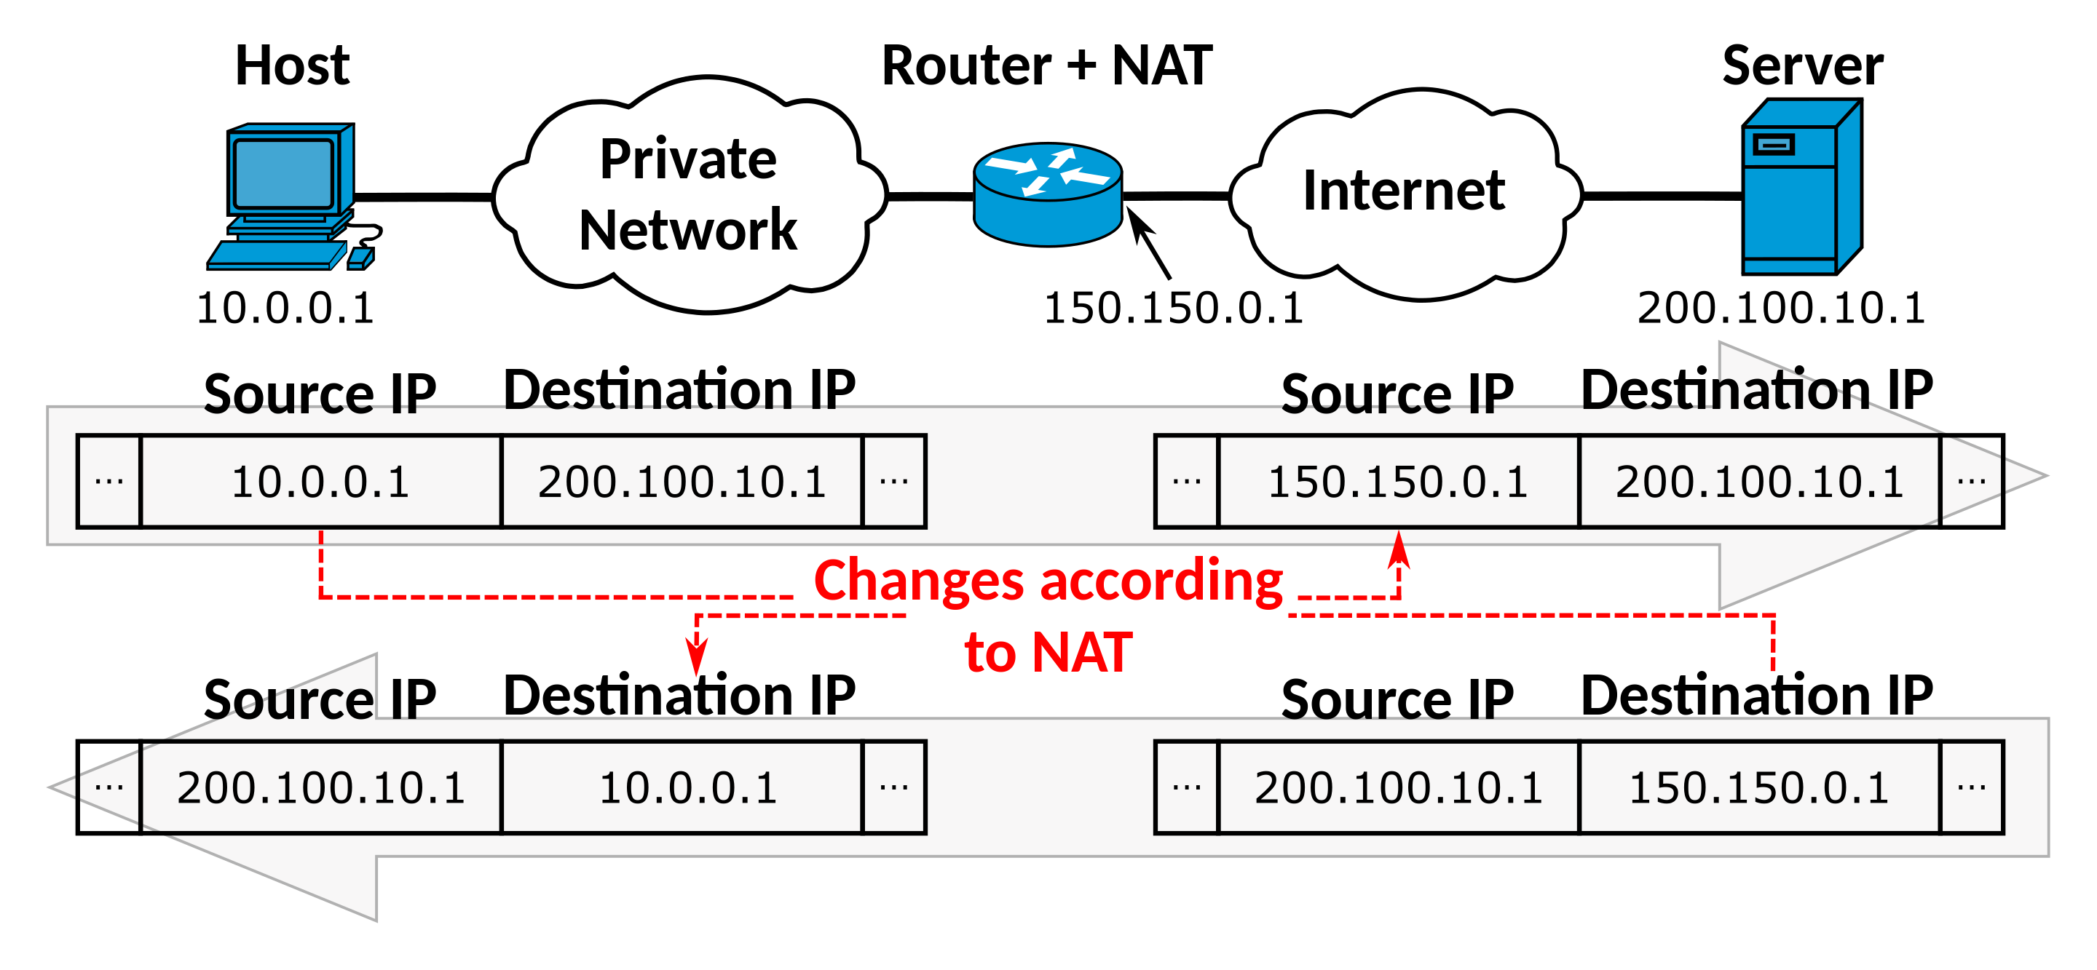
Network Address Translation (NAT)

Slide 18
DNS
How we convert domain names to IP addresses

Slide 19
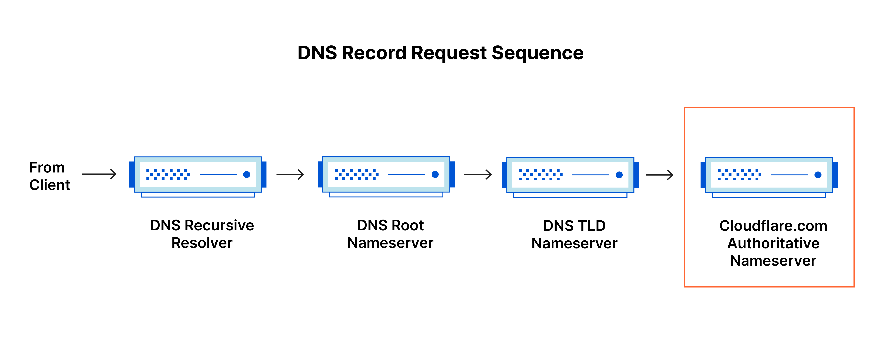
Domain Name System (DNS)
Translates human readable domain names to machine readable IP addresses
DNS servers translate requests (queries) for names into IP addresses, and control which server an end user will reach

Slide 20
DNS Servers
DNS Recursor
Root nameserver
TLD nameserver
Authoritative nameserver
Acts as an intermediary who can get the DNS information. Receives queries from client, makes a series of requests to other DNS servers until it finds the record.
Can directly answer queries for records stored or cached within the root zone. Can also refer queries to the appropriate TLD server.
Hosts the last portion of a hostname (e.g. .com, .net, .gov, etc.)
Where the actual record mapping domain to IP address is kept

Slide 21
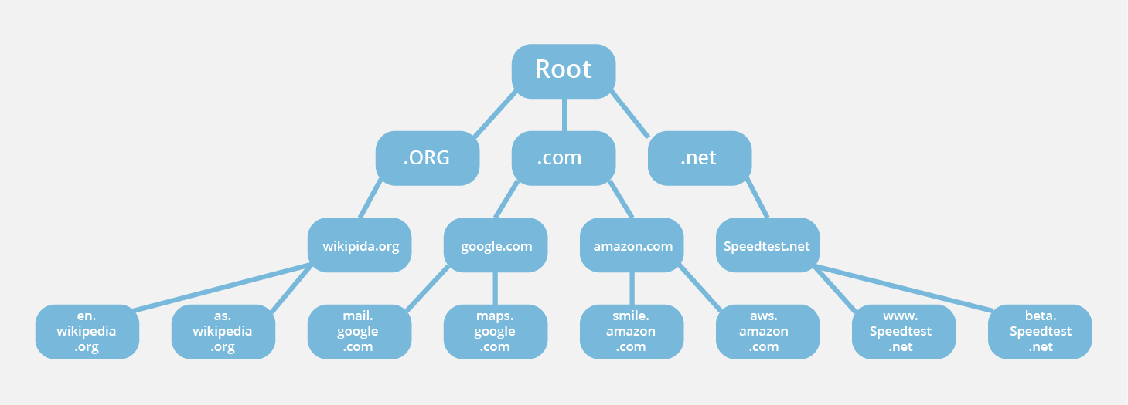
DNS hierarchy

Slide 22
DNS record types
A record: Holds the IPv4 address of a domain
AAAA record: The record that holds the IPv6 address for a domain
CNAME: Forwards one domain or subdomain to another domain, does not provide an IP address
NS record: stores the name server for a DNS entry
SOA record: stores admin information about a domain
SRV record: specifies a port for specific services
PTR record: Provides a domain name in reverse-lookups
MX record: Directs mail to an email server
TXT record: Lets domain admin leave notes on a DNS server

Slide 23
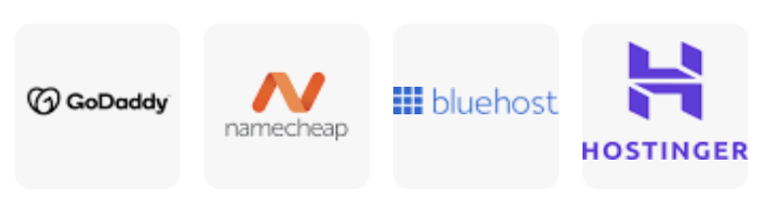
DNS Registrars and Hosting
DNS Registrars provide domain name registrations to the public.
DNS Hosting is a service that runs DNS servers. Most registrars include DNS hosting services.

Slide 24
CLOUD NETWORKING FOUNDATIONS

Slide 25
Key Concepts:
Virtual Private Cloud (VPC)
Public and private subnets
Routing
NAT services
Route tables
Gateways
Load Balancing
Security
Security Groups
Network Access Control Lists (ACLs)
Inter-VPC communication

Slide 26
Note
These concepts are generalizable; AWS, GCP, Azure, DO all have VPCs for hosting your infrastructure
We will use AWS to demonstrate cloud networking concepts
Once you know the foundations, translating them to other CSPs is more manageable!
A live walkthrough of creating a VPC in AWS is provided in the course supplementary materials!
Exact feature parity may vary (bandwidth pricing, default settings for VPCs, etc.)
Always read the documentation!

Slide 27
How do we Handle Virtual Infrastructure Connectivity?
We don’t access the physical network infrastructure of a CSP
So how do we connect our virtual instances, databases, and storage to the internet to serve applications and data?
How do we connect these resources to each other?

Slide 28
We Use Network Virtualization
Network virtualization is software-based versions of networking functions that used to require dedicated network hardware boxes.

Slide 29
Virtual Private Cloud (VPC)
A private Cloud hosted within a public cloud

Slide 30
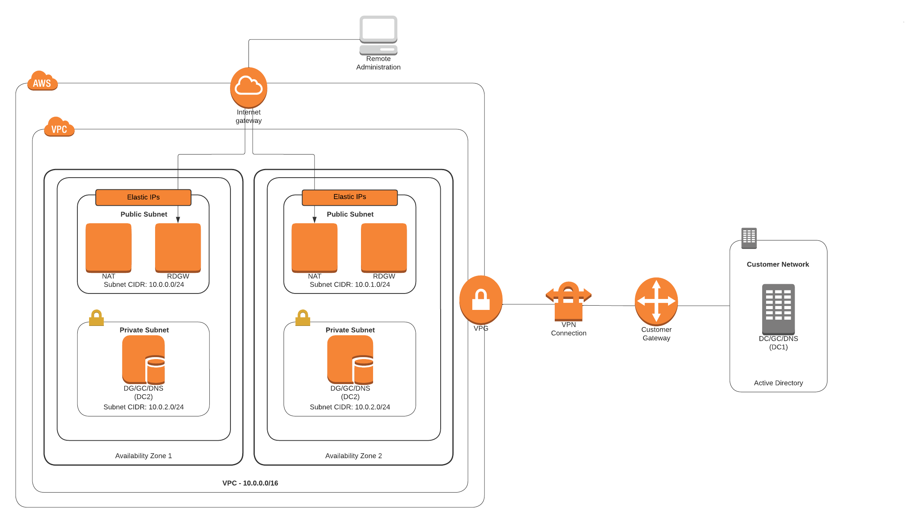
cloud architecture diagram

Slide 31
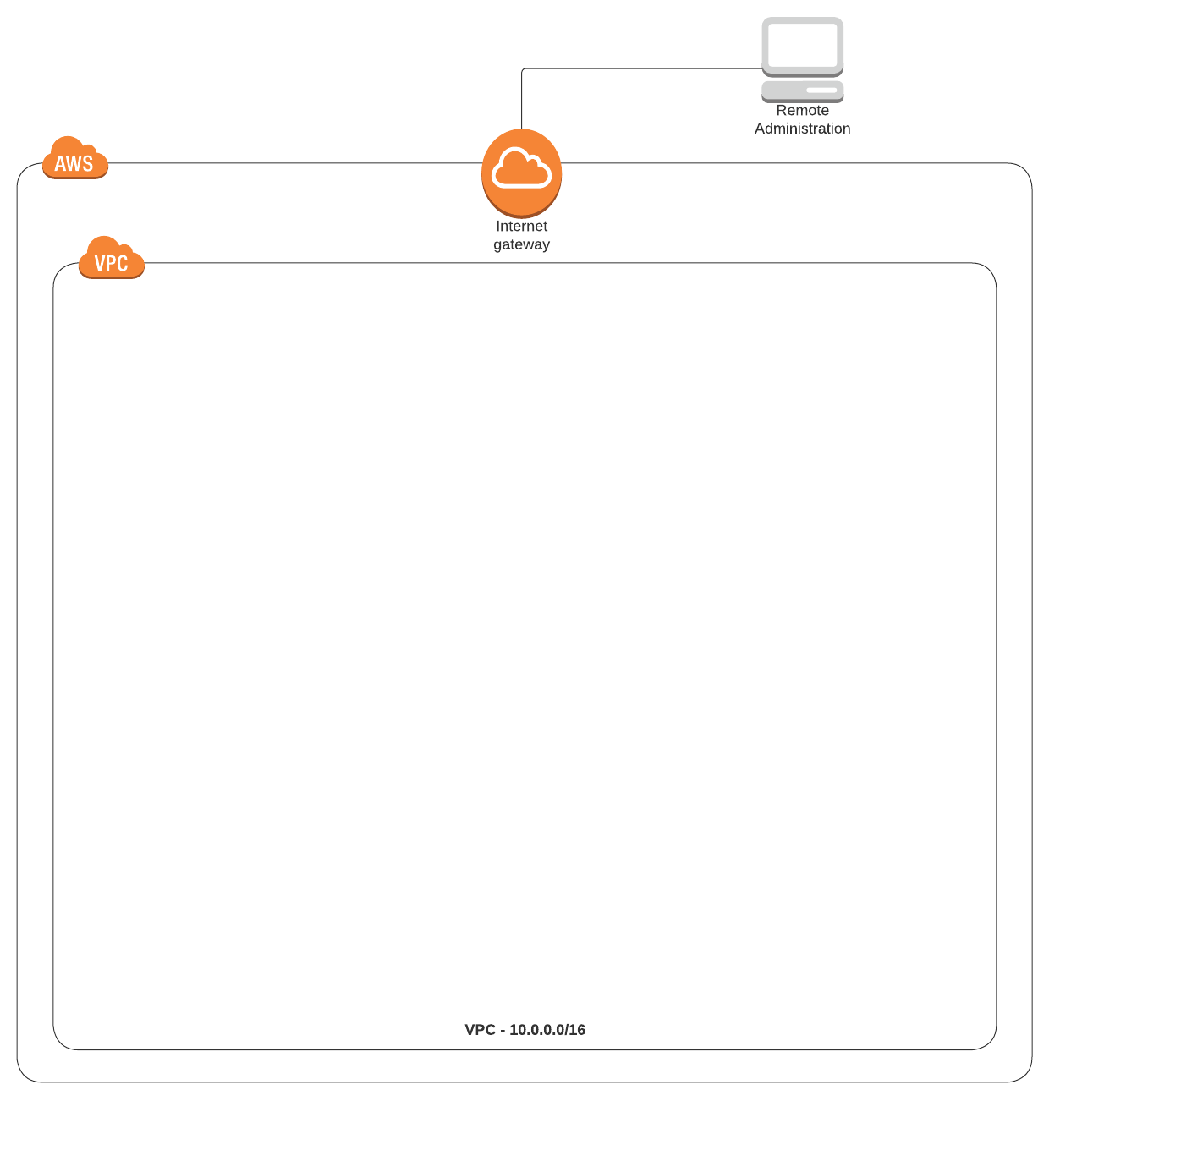
Virtual Private Cloud (VPC)
Isolated private cloud hosted within a public cloud.
Logically isolated virtual network
Provides data and resource isolation
Why use a VPC?
Scalability
Simplifies hybrid cloud deployment
Resource isolation
Simplifies management of cloud resource interconnectivity
Notes:
Scalability: Because a VPC is hosted by a public cloud provider, customers can add more computing resources on demand
Easy hybrid cloud deployment: Relatively simple to connect a VPC to a public cloud or to on-prem infrastructure via the VPN
Better performance: Cloud-hosted websites and applications typically perform better than those hosted on local on-prem servers
Better security: Public cloud providers that offer VPCs often have more resources for updating and maintaining the infrastructure, especially for small and mid-market businesses. For large enterprises or any companies that face extremely tight data security regulations, this is less of an advantage

Slide 32
VPC Isolation and security
Think of the VPC as a logically isolated data center where your instances as AWS services reside.
When you create a VPC, the cloud’s job is to provision, host, and secure the VPC itself. The rest is up to you.
CSP must ensure the continued separation of your VPC from all other customers
CSP is responsible for security of the cloud; you are responsible for security in the cloud.

Slide 33
Virtual Private Cloud (VPC)
Private, meaning you can use the following address ranges in your private subnets
10.0.0.0/8
172.16.0.0/12
192.168.0.0/16
You can create subnets, route tables, ACLs, and gateways to the internet or a VPN endpoint

Slide 34
Creating a VPC (Non-default VPC)
1. Name your VPC
2. Choose an IPv4 CIDR block
3. Configure the subnets and number of Availability Zones (AZs)
4. Set the subnet CIDR blocks
5. Configure a NAT gateway (if needed)
6. Select VPC endpoints
7. Configure DNS

Slide 35
Creating a VPC- Step 1: Naming
1. Name your VPC
”There are only two hard things in Computer Science: cache invalidation and naming things”
- Phil Karlton

Slide 36
Creating a VPC: Naming
Use lowercase and dashes for naming cloud networking services
Examples:
VPC naming:
network-sandbox-vpc
Subnet naming:
network-sandbox-subnet
Security Group naming:
network-sandbox-securitygroup-Developer1

Slide 37
Creating a VPC- Step 2: Choose an IPv4 CIDR Block
1. Name your VPC
2. Choose an IPv4 CIDR block

Slide 38
Creating a VPC- Step 2: Choose an IPv4 CIDR Block
This is the size of the IP space of your VPC.
It needs to be able to accommodate all of the resources in your entire architecture that will live in this VPC.
Each subnet in your VPC will be a segment of IP space from this block
Good practice to use /16 CIDR block so that you can guarantee that your subnets will have enough IP addresses
If you intend on scaling your VMs to many thousands of machines, you need to select a sufficiently large CIDR block for your VPC.

Slide 39
Creating a VPC- Step 2: Choose an IPv4 CIDR Block
CIDR Block | Addresses Range | Hosts
192.168.0.0/16 | 192.168.0.4–192.168.255.254 | 65,529
192.168.0.0/18 | 192.168.0.4 and 192.168.63.254 | 16,379
192.168.0.0/19 | 192.168.0.4 and 192.168.31.254 | 8,187
192.168.0.0/20 | 192.1, 68.0.4 and 192.168.15.254 | 4091
192.168.0.0/21 | 192.168.0.4 and 192.168.7.254 | 2043
192.168.0.0/22 | 192.168.0.4 and 192.168.3.254 | 1019
192.168.0.0/23 | 192.168.0.4 and 192.168.1.254 | 507
192.168.0.0/24 | 192.168.0.4 and 192.168.0.254 | 251
192.168.0.0/28 | 192.168.0.4 and 192.168.0.15 | 11
The first four IP addresses 0, 1, 2, and 3 and the last IP address (255) in each subnet’s CIDR block are reserved for AWS’s use.

Slide 40
Creating a VPC- Step 3: Configure subnets and AZs
1. Name your VPC
2. Choose an IPv4 CIDR block
3. Configure the subnets and number of Availability Zones (AZs)

Slide 41
VPC Subnets
Sub-networks within your VPC

Slide 42
What is a Subnet
A subnet is a way of logically isolating resources within a VPC.
Subnets allow you to have more granular control over which resources can communicate with each other, and which resources are accessible from the public internet.
For example, you can ensure that your databases do not have a direct root to the public internet by placing your database in a private subnet.

Slide 43
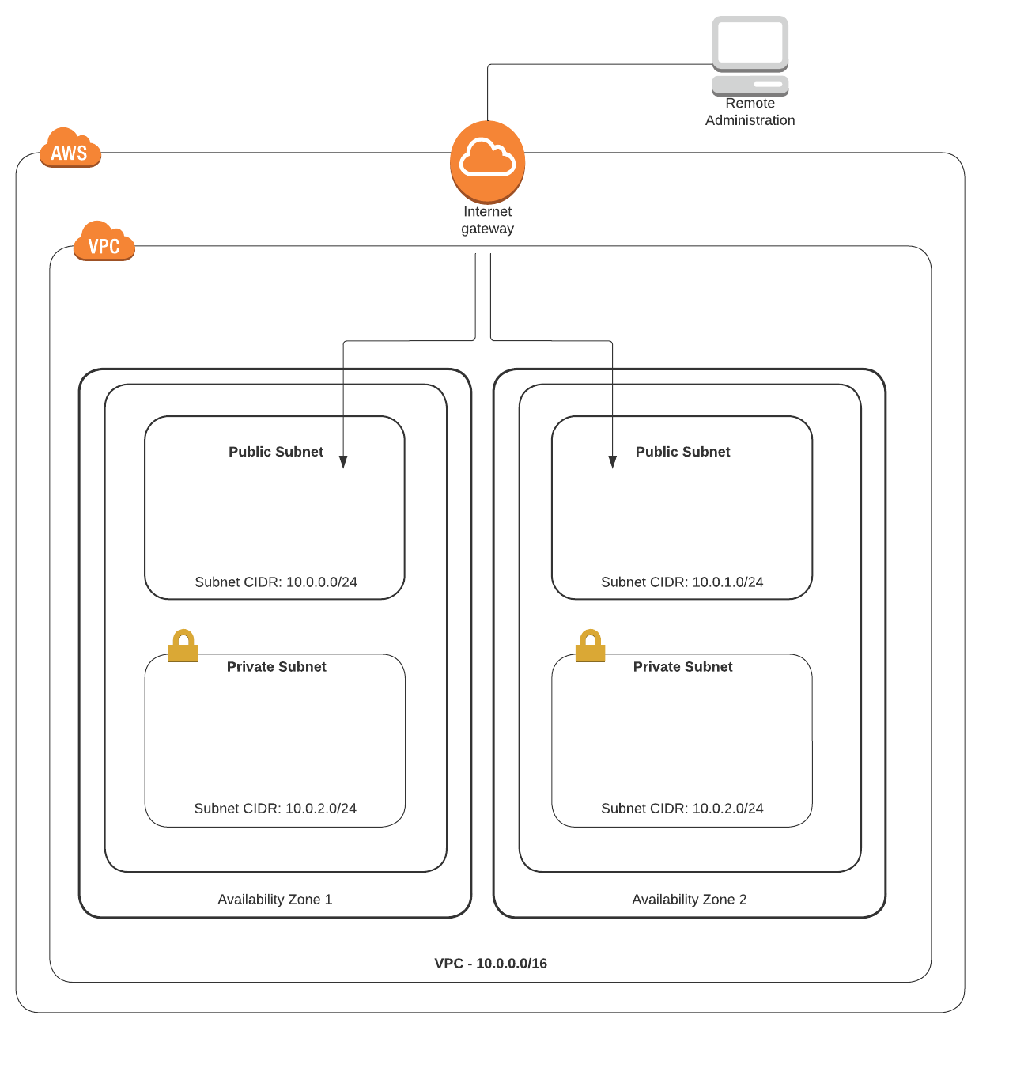
Subnetting in VPCs
Public subnets: For all resources that need to be reachable from the internet
Private subnets: For all resources that should not be reachable from the internet
Key differences:
A public subnet has a route to the internet
A private subnet does not

Slide 44
Subnetting in VPCs
Creating a VPC in AWS using the wizard gives four options:
1. VPC with a single public subnet
2. VPC with public and private subnets
3. VPC with public and private subnets and hardware VPN access
4. VPC with a private subnet only and hardware VPN access

Slide 45
Subnetting in VPCs
Subnet Schema | Why you might want it | Use cases
VPC with single public subnet | You want to run your instance in an isolated environment of AWS Cloud. However, you want to access those instances using the internet. | Simple test environment Public-facing software as a service app Design with multiple VPCs for controlling incoming traffic flow through a transit network
VPC with public and private subnets | You want to run your instance in an isolated environment of AWS. You want to access those instances using the internet. You also want to have an instance that can’t be accessed directly from the internet but that can be accessed from the public subnet. | Multi-tier application Public subnets would be utilized for NAT servers or additional public-facing services like load-balancing services Multiple private subnets could be created and used for hosting, web and app servers, database servers

Slide 46
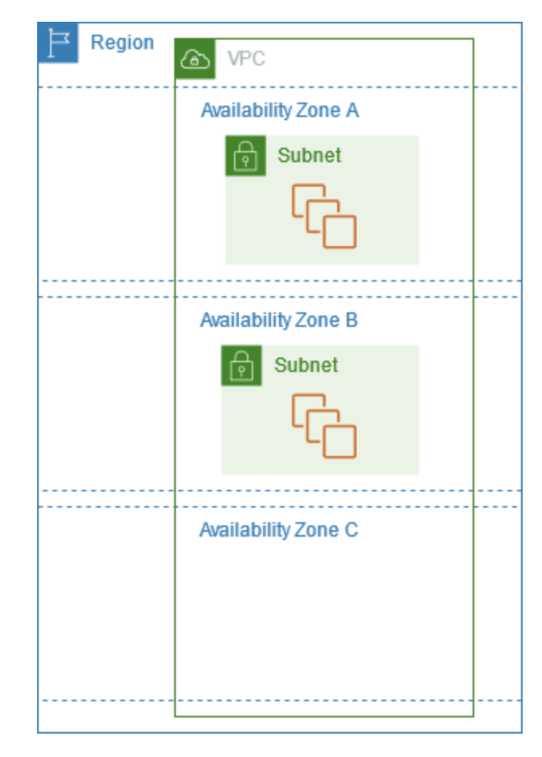
Subnetting in VPCs: Availability Zones (AZ)
Each subnet you create resides within its assigned AZ.
If you choose to design your applications for resiliency and uptime, you’ll want to design your solution using at least two AZs.
Subnets are contained within an AZ
You launch instances into subnets
Availability Zone C has no subnet, so you can’t launch an instance there.

Slide 47
Creating a VPC- Step 4: Set the subnet CIDR Blocks
1. Name your VPC
2. Choose an IPv4 CIDR block
3. Configure the subnets and number of Availability Zones (AZs)
4. Set the subnet CIDR blocks

Slide 48
Creating a VPC- Step 4: Set the subnet CIDR Blocks
Both IPv4 and IPv6 subnets are supported within a VPC.
CIDR blocks must not overlap with any existing CIDR blocks within a VPC or with another VPC connected with a peering connection.
You can’t have two subnets with the same CIDR block
The size of an existing CIDR block cannot be increased or decreased. It is locked after creation.
You can’t change the original CIDR block, but you can add up to 4 CIDR blocks if you need more IP space
If you add a CIDR block, the new route is automatically added to the VPC main route tables
Notes:
Always check with your network admins. I still call my old network admin at Carnegie. He knows things.

Slide 49
Other notes about Subnets
VPN- only subnets
Have access to a VPN connection (typically to and from a head office or DC)
Traffic between subnets of a VPC is always routed by default. You can’t remove the routes between the subnets.
If you want to prevent traffic between subnets in a VPC, you need to use network address control lists (NACLs) attached to the subnets (we go over this later)

Slide 50
Creating a VPC- Step 5: Configure a NAT Gateway
1. Name your VPC
2. Choose an IPv4 CIDR block
3. Configure the subnets and number of Availability Zones (AZs)
4. Set the subnet CIDR blocks
5. Configure a NAT gateway

Slide 51
NAT Services
NAT Gateways

Slide 52
NAT Gateways
Network address translation (NAT)
Controls traffic so that instances in a private subnet can connect to services outside of your VPC, but external services cannot initiate a connection with those instances.
Internet gateways allow both inbound and outbound access to the internet, whereas the NAT Gateway only allows outbound access.
Internet Gateway allows instances with public IPs to access the internet
NAT Gateway allows instances with private IPs to access the internet

Slide 53
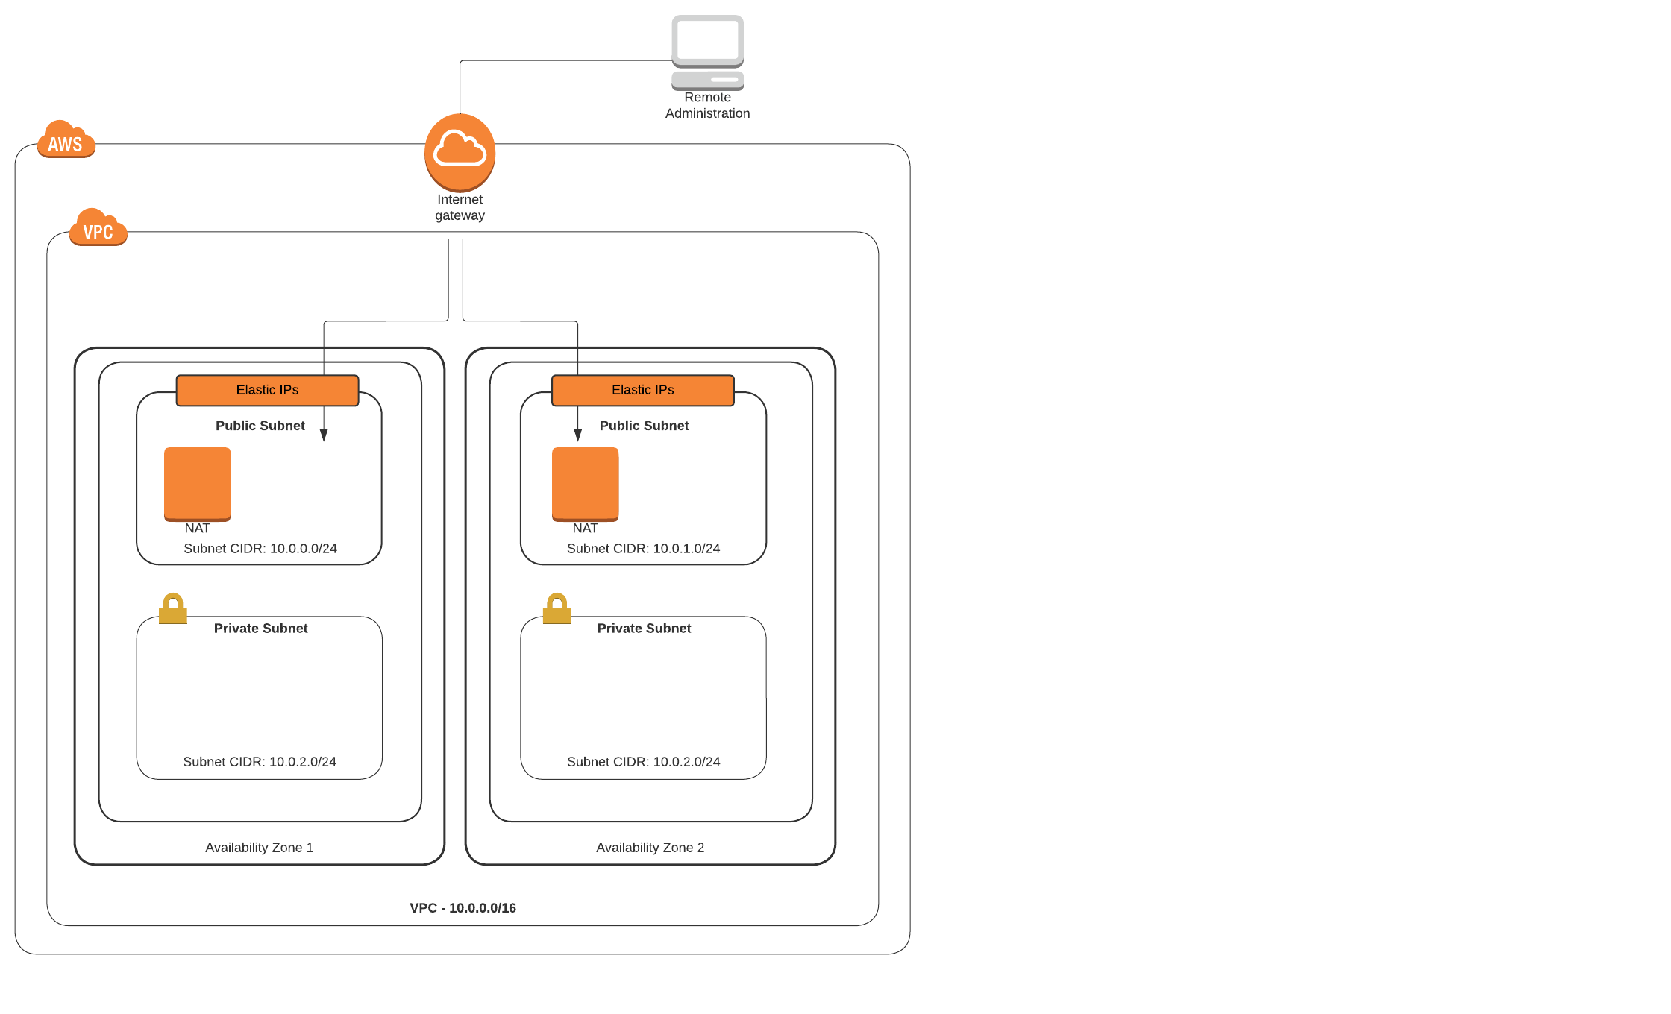
NAT Gateways
Always placed in a public subnet and configured with an Elastic IP address (static public IP address)
Elastic IP is for public communications, and the private IP is for the private communications with the private subnets.
NAT Gateways are created in each AZ and ensure the route tables in each private subnet point the EC2 instances to the correct gateway location

Slide 54
Elastic IPS

Slide 55
Elastic IP addresses
AWS-assigned public IP address is detached when an EC2 instance is turned off.
Once the instance is turned back on, AWS assigns a new public IP address.
If you need the same public IP address to persist, use an Elastic IP (EIP) address.
Public elastic IP address is a static IP address that after creation is assigned to your account at AWS.
If you turn your instance off and back on, the EIP is still assigned
If you don’t assign the EIP after you receive it, you’re still charged.

Slide 56
Elastic IP addresses
Each EC2 instance that receives a public IP address at AWS is also provided with an external DNS hostname.
The external DNS hostname is resolved to the public IP address of the EC2 instance when queries are external to AWS.

Slide 57
When to Use Elastic IP
NAT instances
Public-facing and private load balancers
NAT gateway services
Not needed for EC2 instances

Slide 58
Route Tables
More about route tables

Slide 59
Route Tables
Collection of rules that dictate where egress subnet network traffic can flow to.
Each subnet needs a route table

Slide 60
Route Table Key Concepts
Concept | Description
Main route table | The route table that automatically comes with your VPC. Controls routing for all subnets that are not explicitly associated with any other route table.
Custom route table | A route table that you create for your VPC
Destination | The range of IP addresses where you want traffic to go (destination CIDR)
Target | The gateway, NIC, or connection through which to send the destination traffic (e.g. an internet gateway)
Route table association | The association between a route table and a subnet, IGW, or virtual private gateway
Subnet route table | A route table that’s associated with a subnet
Local route | A default route for communication within the VPC
Gateway route table | A route table that’s associated with an internet gateway or virtual private gateway

Slide 61
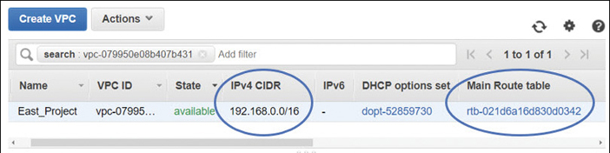
Route Tables: The Main Route Table
VPC handles local routing
Leave the main route table in its default state; this ensures that if you assign the main route table by mistake to a subnet, the worst that can happen is local routing.
Whenever a subnet is created in a VPC, the main route table for the VPC is updated

Slide 62
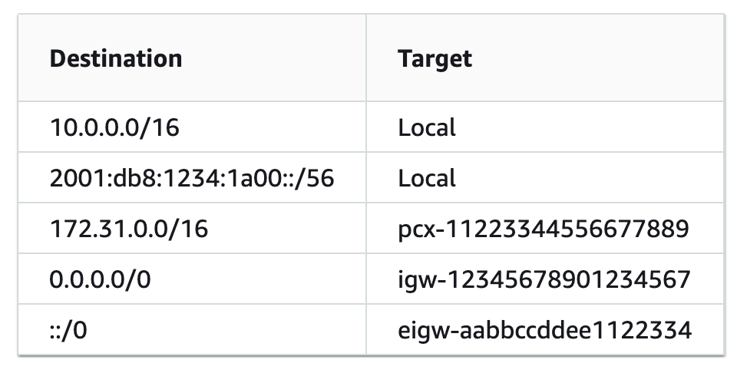
Route Tables
Single route table can be assigned to multiple subnets
Each route table entry defines a destination in CIDR notation and an external target
Best practice: create custom route tables for each tier in your network design.
Granular control of traffic flow within each subnet.
Notes:
PCX is a peering connection

Slide 63
Route Tables
Public subnet route table
Public-facing infrastructure routing table:
ELB, NAT gateway services
Add a route for the IGW enabling public network traffic between network interfaces hosted on the public subnets and the attached internet gateway
Internet gateway routes are set with a destination route of 0.0.0.0/0 because the destination may be anywhere on the public internet.

Slide 64
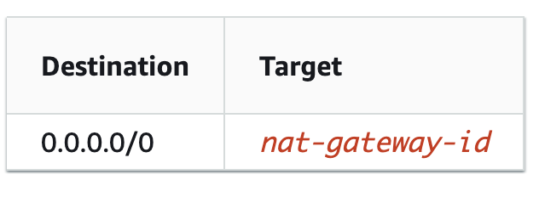
Route Tables
Private subnet:
Application and database tiers routing table
To enable EC2 instances on a private subnet to connect to the internet and receive updates, the NAT gateway service will be hosted on public subnets within each AZ.
Routes pointing to the NAT gateway service must be defined in the route table associated with the private subnets.

Slide 65
Route Tables: A Note about Cost
EC2 instances using private IP addresses located on subnets in different AZs are charged an outbound data transfer fee for communicating with each other.
There’s no fee for data transfer between EC2 instances using private IPs on the same subnet.
Private IPs are cheaper than public IPs.
Public and private traffic are charged differently; private traffic traveling within AWS data centers is always cheaper than traffic on a public subnet.
All inbound communication traffic that an EC2 instance receives is free, regardless of whether it comes form inside AWS or from the public internet.
Database replication traffic across multiple AZs is charged a data transfer fee.

Slide 66
Creating a VPC- Step 6: Select VPC Endpoints
1. Name your VPC
2. Choose an IPv4 CIDR block
3. Configure the subnets and number of Availability Zones (AZs)
4. Set the subnet CIDR blocks
5. Configure a NAT gateway (if needed)
6. Select VPC endpoints

Slide 67
VPC Endpoints
Gateway VPC endpoints
Interface VPC Endpoints

Slide 68
Internet Gateway (IGW)
Must attach an IGW to the VPC before traffic can flow to or from the internet
After creating the IGW, associate it with the desired VPC
Update the route tables to allow subnets to send their public traffic to the IGW
Default destination route assigned to an IGW is 0.0.0.0/0
Can limit to a specific IP range (company HQ, DC, etc.) or other EIP, BYOIP
NAT is performed on all outgoing public traffic

Slide 69
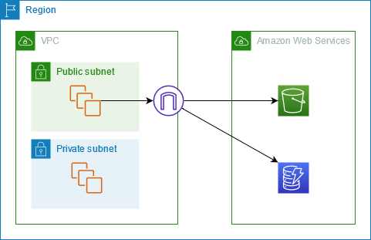
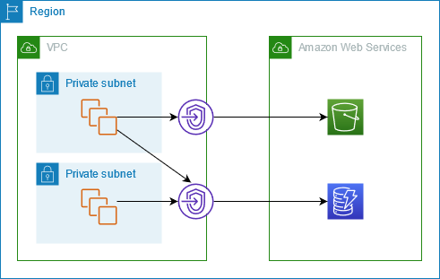
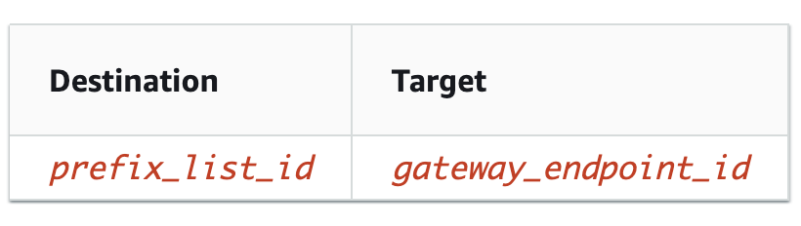
Gateway VPC Endpoints
Connect VPC subnets to AWS services without requiring an internet gateway, a VPN connection, or peering connection
Highly available service, horizontally scaling
Access to S3 or DynamoDB carried out across a gateway VPC endpoint, acts as a secure tunnel connection
Traffic never leaves the AWS private network

Slide 70
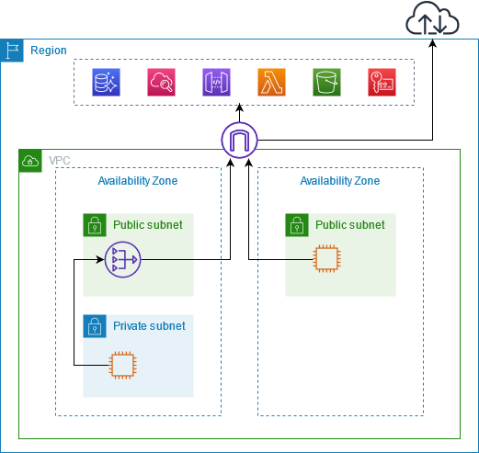
Interface VPC Endpoints: Public Service Endpoints
Traffic to AWS service from an instance is routed to IGW (or NAT gateway → IGW if private subnet) then to the AWS service.
Traverses the gateway but does not leave the AWS network.

Slide 71
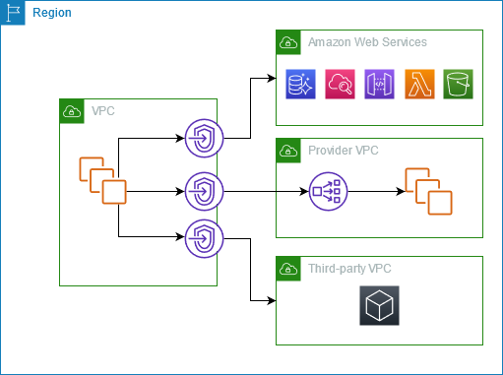
Interface VPC Endpoints Connections
AWS Services
Services hosted on another AWS account
Services from a third-party vendor

Slide 72
Interface VPC Endpoints
Access AWS services using an endpoint
Default service endpoints are public interfaces
Have to have an IGW so that traffic can get from VPC to AWS service
Alternatively, use AWS PrivateLink to connect VPC to AWS services as if they were in your VPC without use of IGW.

Slide 73
Interface VPC Endpoints With Private Link
The interface is a network adapter designated with a private IP address
AWS resources with an interface connection appear to be in your VPC because they are accessed using a private IP from the linked VPC
Facilitated via PrivateLink
Creates an EIP, defined as a private static IP address behind every interface connection
PrivateLink endpoint connections combined with Direct Connect connections delivers AWS services in a totally private environment
Especially helpful for corporations who can only have private hybrid cloud architecture

Slide 74
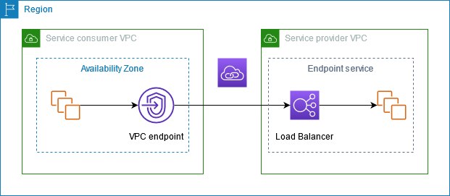
Interface VPC Endpoints: Provider/Third-party With Private Link
Service consumers create interface VPC endpoints to connect to endpoint services that are hosted by service providers.

Slide 75
Creating a VPC- Step 7: Configure DNS
1. Name your VPC
2. Choose an IPv4 CIDR block
3. Configure the subnets and number of Availability Zones (AZs)
4. Set the subnet CIDR blocks
5. Configure a NAT gateway (if needed)
6. Select VPC endpoints
7. Configure DNS

Slide 76
Route 53
AWS DNS

Slide 77
Route 53
AWS DNS Service
Typically hosted behind AWS services with DNS names that are stored and referenced through Route 53
ELB, CloudFront, S3
Also a registrar
Manages your public DNS records that are connected to public IP addresses
Can be short-term IP address pool, EIP, BYOIP

Slide 78
Route 53
Can use Route 53 to host a private domain that you’ve created within a VPC
AWS supports a DNS record type called an alias record
Map resource records within your hosted zone to a variety of AWS services
ELB, CloudFront, etc.
Routes traffic from one record within a hosted zone to another record
Works like a CNAME record
Can contain multiple records associated with a single resource name
Allows Route 53 to respond if necessary with more than one IP address for the load-balancing service in times of internal changes to the service

Slide 79
Route 53
CNAME record = only one IP address <> DNS name can be referenced
Each CNAME query costs $
Alias record = multiple IP addresses <> DNS name can be referenced
Alias record query = free
BUT an alias record only points to a supported AWS resource or to another DNS record within the hosted zone where the alias record has been created

Slide 80
Routing Options
Routing Options | Details
Simple | For a single resource; a Web instance
Failover | Active-passive failover; from one resource to another
Geolocation | Route traffic based on user’s location
Geo-proximity | Route traffic based on location of resources
Latency | Route traffic to AWS resources with the least latency
Multi-value answer | Answer queries with multiple healthy records
Weighted routing | Route a percentage of traffic to resources; Blue-Green

Slide 81
Route 53
Health checks
Verify that your applications are reachable and available
Evaluates Target Health parameter
Route 53 can failover to a backup site location (S3 bucket, external location) when your VPC becomes unavailable for whatever reason
Internally, Route 53 monitors failed endpoints, when the failed endpoint passes its health check, Route 53 updates its DNS records accordingly

Slide 82
Route 53 Private DNS Zones
Allows authoritative DNS services to be hosted within your VPCs with no internet exposure.
After creating a private hosted zone, Route 53 only returns records when queried from within the VPC
Each custom VPC has attributes for DNS that can be customized
If both vals == True: instance receives public DNS hostname, Route 53 resolves any Amazon-provided private DNS hostnames
If ! both vals == True: instance will not receive a public DNS hostname and Route 53 will not resolve the private DNS hostname
VPC DNS Attribute | Default VPC | CLI, API, or AWS SDK | Your VPC Wizard | VPC Wizard
Enable DNS hostname (Public) | True | False | False | True
Enable DNS support | True | True | True | True
Best practice: user requests should be routed to a load balancer and not directly to the instance

Slide 83
Next Lecture: More Cloud Networking Topics
Load Balancing
Security Groups
Network Access Control Lists (NACL)
BYOIP
More VPC Connectivity Options
VPC Design Considerations

Slide 84
Refences
Willis, Mark. Learning Amazon Web Services (AWS): A Hands-On Guide to the Fundamentals of AWS Cloud. Addison-Wesley Professional. 2019.

Slide 85
Land Acknowledgement Statement
We respectfully acknowledge the University of Arizona is on the land and territories of Indigenous peoples. Today, Arizona is home to 22 federally-recognized tribes, with Tucson being home to the O’odham and the Yacqui. Committed to diversity and inclusion, the University strives to build sustainable relationships with sovereign Native Nations and Indigenous communities through education offerings, partnerships, and community service.

